Slide 1
Identity
GNED400 – K Pandolfi

Slide 2
Learning Outcomes
• List factors that shape individual identity. • Identify ways societies structure around identity difference. • Describe how the make up of one’s identity impacts an individual’s relationship to social structures.

Slide 3
Socialization
Socialization is a learning process that involves development or changes in the individual’s sense of self (i.e. identity)
Primary socialization is the socialization that occurs during childhood
Secondary socialization is the socialization that occurs later in life

Slide 4
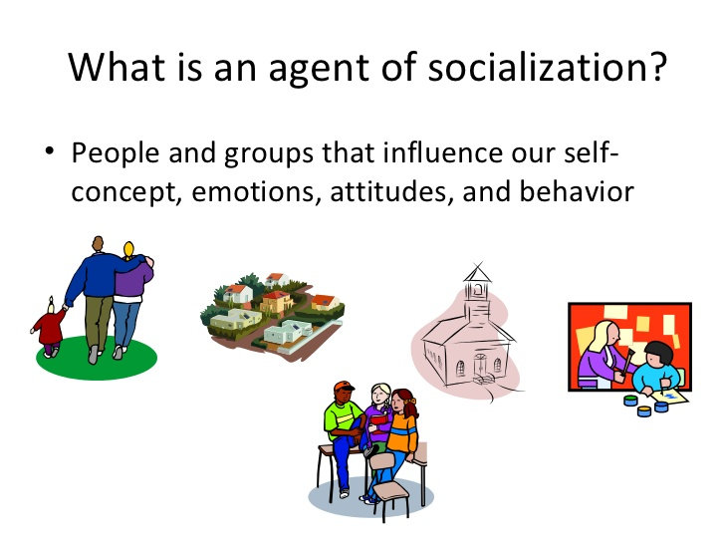
Agents of Socialization
Agents of socialization: groups that have a significant impact on one’s socialization
For example: family, peers, neighbourhood/community, school, mass media, the legal system, one’s own culture

Slide 5


Family
Language, rules, morals, role models, behaviours, social interactions
School
Grammar, rules, social setting, values
Peers
Activities, trends
Clubs/social groups
Social interactions, rules governing activities
Agents of Socialization
Religion
Values, meaning of life, guidelines on how to live
Ethnic background
Beliefs,
Values,
customs
Government
Laws, sense of security, sanctions or punishment
Work
Employment, money, rules, roles
Media
Stereotypes, trends, how to act

Slide 6

Socialization: Family Expectations
(https://www.youtube.com/watch?v=3DdVk1wHEqw)

Slide 7

Peer Pressure experiment
(https://www.youtube.com/watch?v=MEhSk71gUCQ)

Slide 8
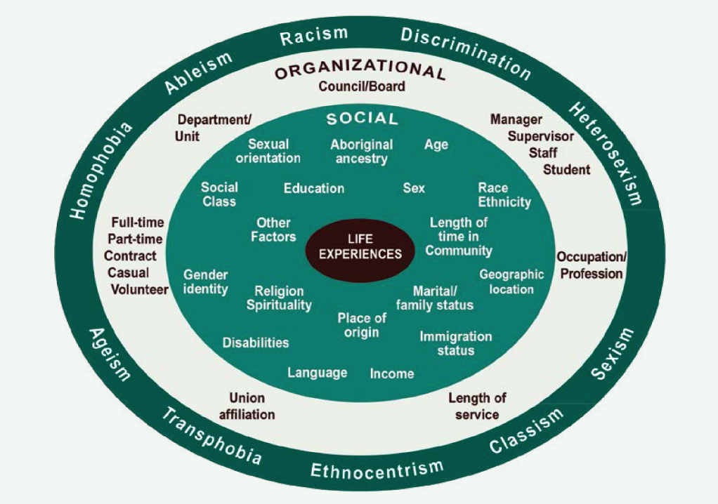
Factors Shaping Identity
Intersectionality
Wheel
INNER CIRCLE
Life experience shapes individual identity.
FIRST RING
Social factors impact life experience.
SECOND RING
A person’s organization position (social location) is determined by social factors.
OUTER Ring
Systems of power surround and influence individual identity.
Source: E&I Lens Handbook. City of Ottawa and City for All Women Initiative

Slide 9
Some concepts to help in understanding identity - privilege and oppression
social location refers to the groups one belongs to, to one’s place in history and in larger society.
social capital is the expected collective or economic benefits derived from the preferential treatment and cooperation between individuals and groups
cultural capital refers to non-financial social assets that promote social mobility beyond economic means. Examples can include education, intellectual expression, style of speech, dress, or physical appearance
entitlement refers to an individual’s sense of having a right to have, to do, or receive something; the feeling or belief that one deserves benefits or privileges.
privilege refers to unearned economic, social and political advantages and power based on belonging to dominant groups in any society
.
Source: Cultural Safety Module 2: Peoples’ Experiences of Oppression. University of Victoria.

Slide 10
Social Location and Oppression
The large systems of power in a society can rank social locations and create hierarchies that privilege some over others.
Patterns of natural difference can become systems of inequality and privilege.

Slide 11
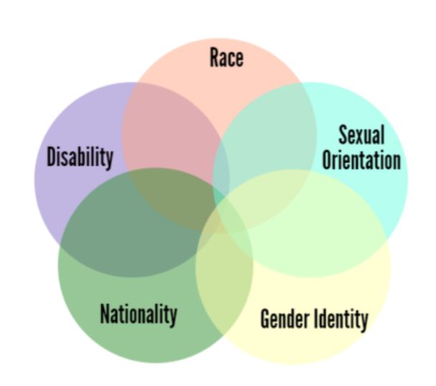
Intersectionality
Understanding that oppression arises out of the combination of various oppressions which, together, produce something unique and distinct from any one form of discrimination standing alone.
An intersectional approach takes into account the historical, social and political context and recognizes the unique experience of the individual based on the intersection of all relevant factors of identity.
Source: What is intersectionality, and what does it have to do with me?. YW Boston.
(Concept of intersectionality attributed to Kimberle Crenshaw).
Source: Introduction to the Intersectional Approach. Ontario Human Rights Commission

Slide 12
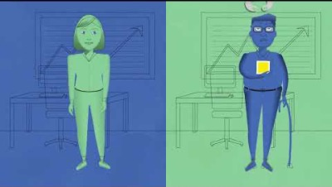
Intersectionality
(https://www.youtube.com/watch?v=O1islM0ytkE)

Slide 13
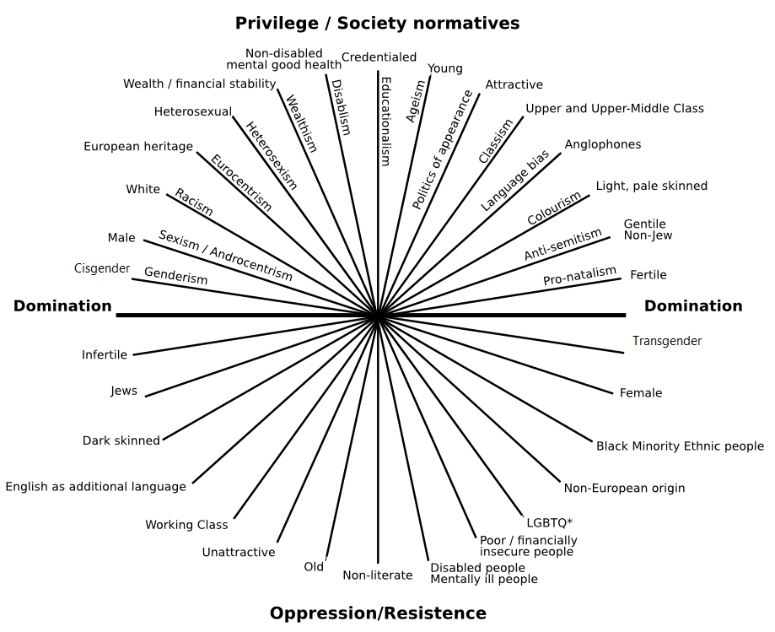
Intersecting Axes of Privilege, Domination, Oppression and Resistance North America
Source: Shaw, Susan and Janet Lee. Women’s Voices. Feminist Visions.

Slide 14
Consider the Intersectionality Wheel
What social factors shape your identity?
Are there social factors missing from the wheel?
How do the factors connect to one another?
Which factors do you think bring you advantages? Disadvantages?
Think – Pair - Share
Source: Shaw, Susan and Janet Lee. Women’s Voices. Feminist Visions.

Slide 15
History of Oppression and Resistance in Canada
Colonization marked by genocide, slavery, and land seizures.
1867 Canada established. Government gives 10 acres of land to White and 1 acre to Black citizens.
1876 Indian Act puts all aspects indigenous life under Government control.
1876 Ontario opens its first institution for people with mental disabilities.
1879 – 1996 Canadian Indian Residential School system in place.
1885 Chinese labourers brought to build railway and paid ¼ the wage of that paid to White workers.
1908 Immigration denies people of “any race deemed unsuitable to the requirements of Canada.”
1914 352 passengers from India turned away at Port of Vancouver due to exclusion laws.
1939 Entry to Canada denied to 907 Jewish refugees aboard the MS St. Louis.
1941 Japanese Canadians imprisoned and property seized.
1971 Multiculturalism Policy affirms dignity of all Canadian citizens regardless of race or ethnic origin.
2008 - Series of apologies (Residential Schools, Japanese Internment, Refusal of Jewish Refugees, Mistreatment of LGBTQ2S).
2008 Ontario closes last three residential homes for individuals with mental disabilities.
2013-14 Settlements in cases against Ontario’s residential institutions for adults with mental disabilities for emotional, physical and psychological mistreatment.

